Slide 1
Risk Report:
Conflict Analysis: Sudan
Anshul Kamble • 10.11.2024

Slide 2
Overview
Sudan is currently experiencing a severe crisis marked by escalating political violence and widespread food insecurity. The conflict primarily involves two major factions: the protestors and rioters. This conflict fired up as the future-democratic government was dissolved by Omar Al-Bashir, and led to massive civilian displacement, disrupted agricultural activities, and strained food supply chains, plunging millions of people into acute food insecurity. The violence has also hindered economic stability, further aggravating an already critical humanitarian situation.
This situation is particularly important for the United Nations Development Programme (UNDP), which is responsible for fostering sustainable development and peacebuilding. By analyzing data from ACLED, UNHCR, and FEWS.NET, this project examines the interplay between political violence, refugee movements, and food insecurity in Sudan. Understanding these dynamics is essential for UNDP to develop effective strategies that address both immediate humanitarian needs and long-term stability. The findings help guide decisions on resource allocation, peacebuilding efforts, and international humanitarian responses, ultimately aiming to mitigate the risks of famine and promote a peaceful transition in Sudan.

Slide 3
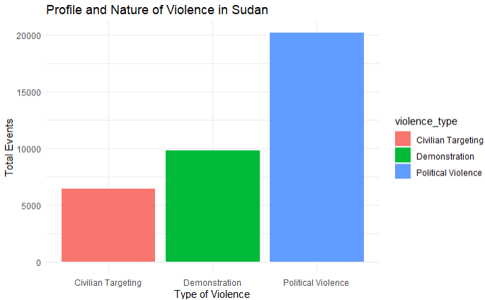
Profile and Nature of Violence in Sudan
This bar blot shows the frequency of the most occurring kinds of violence in Sudan, with Political Violence reaching staggering heights.

Slide 4
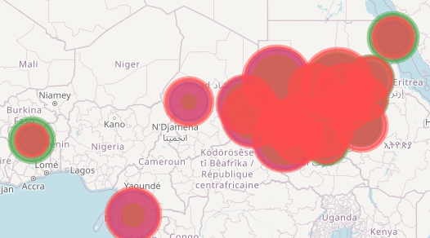
Conflict hotspots
Observation: areas of political violence are majorly the same areas for other kinds of violence. It can be inferred that political violence propels other kinds of violence in some regions.
Darfur, Blue Nile, and Khartoum - are the most heated regions in all kinds.

Slide 5
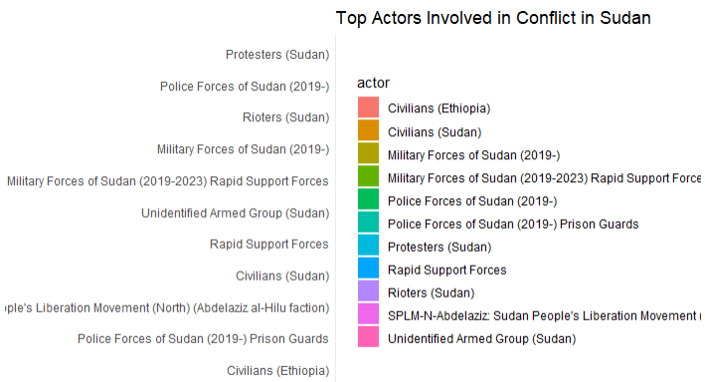
Main parties involved
List of all parties- protestors and civilians included.

Slide 6
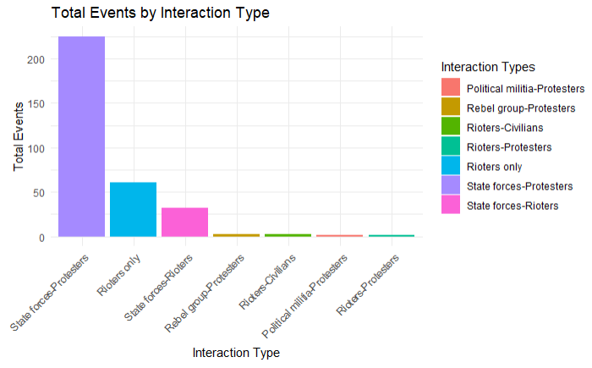
Topmost rival parties
List of all parties with the most number of total events facing each other.
Format - PartyA-PartyB

Slide 7
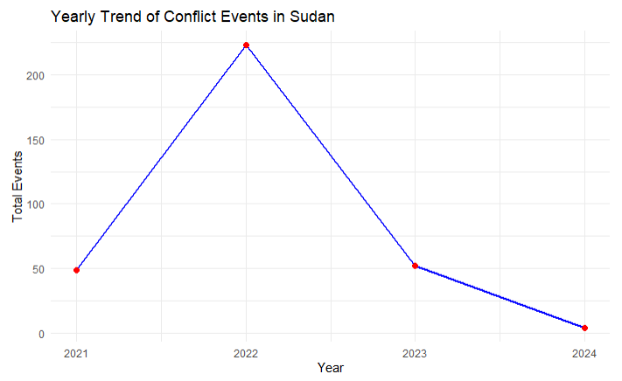
Analyzing trends over time
The sudden increase in political conflicts in 2022 is due to the dissolvement of the civilian-led government by the coup led by Omar al-Bashir in October 2021.

Slide 8
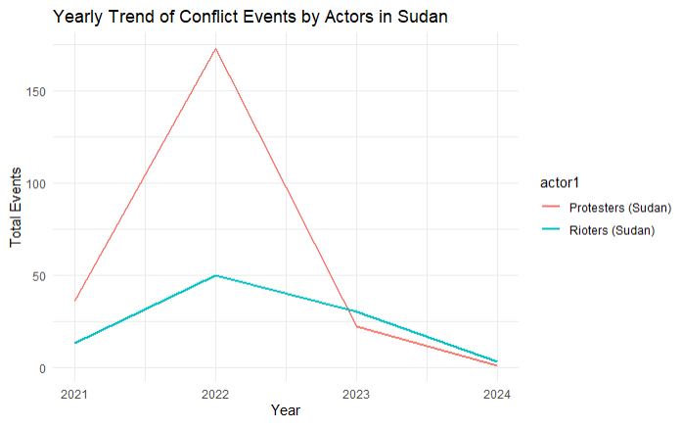
Analyzing trends over time for the two blocks
With the displacement of a future-democratic government, the response was increased conflicts initiated by protestors to fight back for democracy, having lived years in dictatorship.

Slide 9
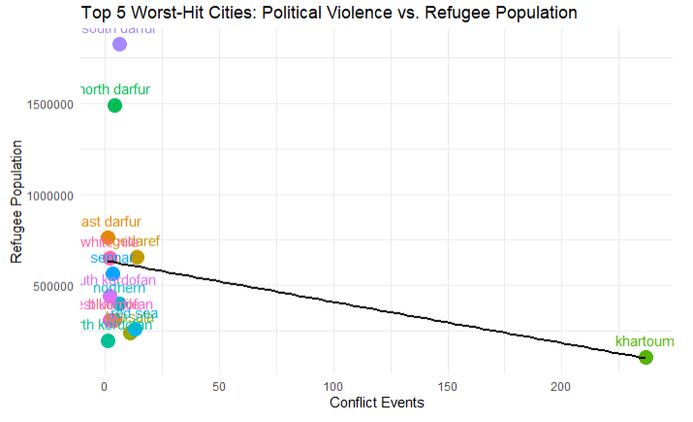
Refugee connection to political violence
This linear regression model shows the relationship between internal refugee population in a city depending on the frequency of conflicts in that city.
Hotspot cities lead to severe displacement of people internally, forcing people to move out, thus increasing refugees in neighboring cities and decreasing refugees in their own city.

Slide 10
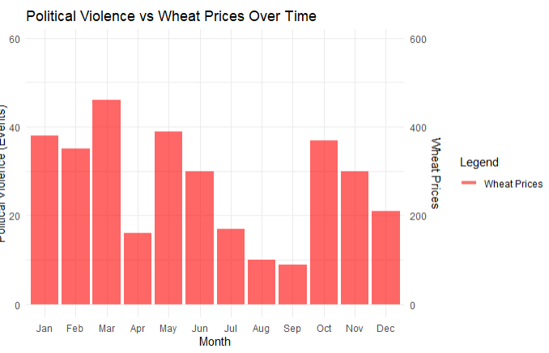
Food insecurity: Millet and wheat availability vs Political Violence
From both graphs, there could be a possibility that decrease in conflicts could lead to decrease in food prices, as seen from May - September.
There is no convincing proof from this analysis that political violence has led to significant increase in food insecurity.

Slide 11
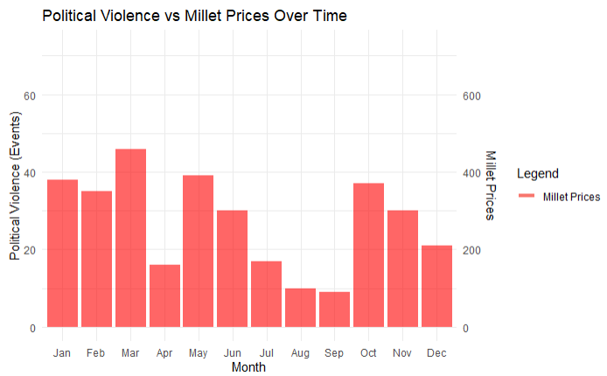
Food insecurity: Millet and wheat availability vs Political Violence
From both graphs, there could be a possibility that decrease in conflicts could lead to decrease in food prices, as seen from May - September.
There is no convincing proof from this analysis that political violence has led to significant increase in food insecurity.

Slide 12
Methodologies used
Tidyverse & dplyr
  Data pipeline (%>%) to merge data
Ggplot2 to visualize data
  Layers (ggplot, geom_line, geom_points, geom_smooth, geom_bar
  Linear regression method
OSM Geocoding for map generation
  Tmap, sf
  geocode() to generate Latitude and Longitude coordinates
  Leaflet
    addTiles() and addCircleMarkers() to mark data on Sudan Map
Exploratory Data analysis
  str(), head(), summarize(), mutate()

Slide 13
Credits and Datasets
https://data.unhcr.org/en/situations/sudansituation
https://data.humdata.org/dataset/sudan-acled-conflict-data
https://acleddata.com/data-export-tool/
https://data.unhcr.org/en/country/sdn
https://www.ipcinfo.org/ipc-country-analysis/details-map/en/c/1156504/?iso3=SDN
https://fews.net/
ChatGpt: Generative AI
R Studio
Google Slides

